Slide 1
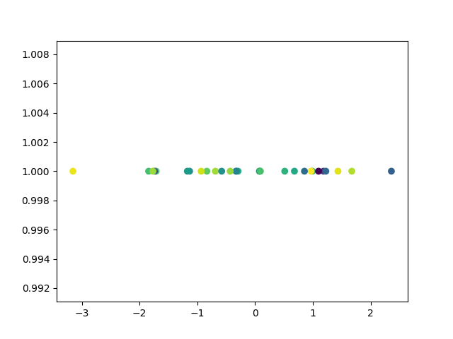
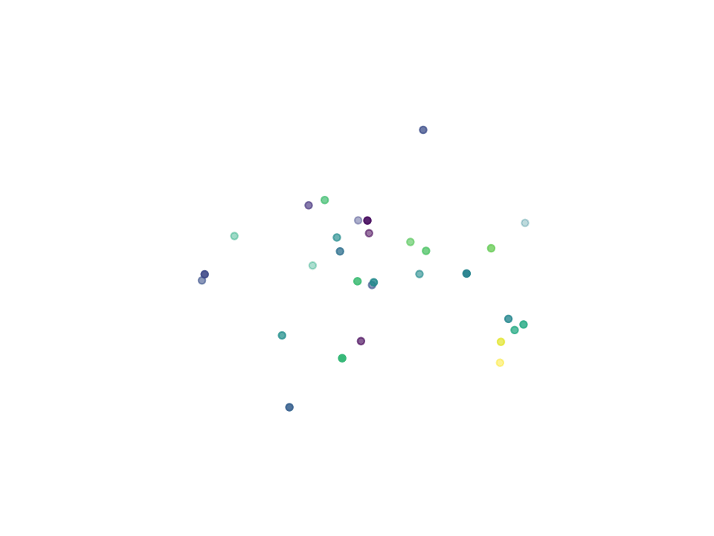
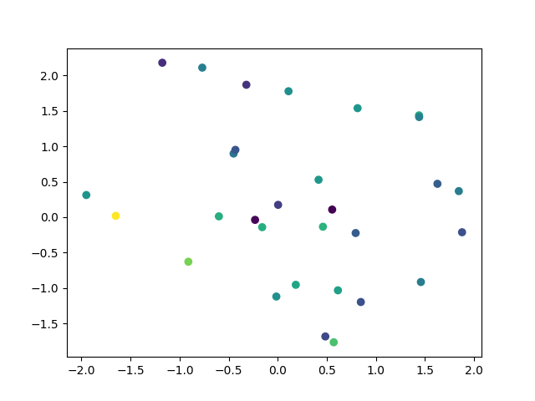
Issues with Distances in High Dimensions
1 Dimension
3 Dimensions
2 Dimensions
Notes:
Buckle in
Imagine 2 points are close in 1 dimension, when we introduce the 2nd dimension they must also be close in that dimension for them to still be “close.” We can see this going from 1 to 2 to 3d in the graphs. Now imagine adding 22 more dimensions. What are the odds they are close in all 24?
Following this logic, it can be shown (via mathematical proof) that all distances between points approach equality as dimensions go up.
So any of methodology which deals with distances between points (aka all of them) become worthless. This is the so-called “curse of dimensionality”

Slide 2
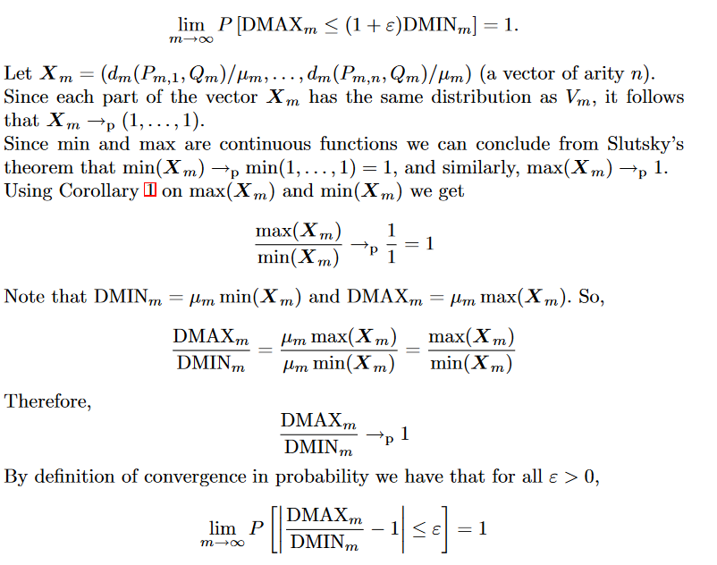
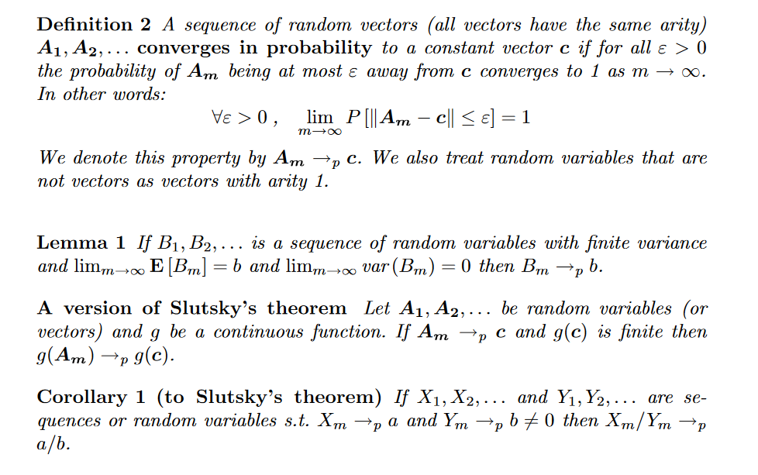
Some Light Reading
Beyer, K.; Goldstein, J.; Ramakrishnan, R.; Shaft, U. (1999). "When is "Nearest Neighbor" Meaningful?".
Notes:
This is part of the math used in the proof, its not fun, its 19 pages. If anyone wants to see we can send around this paper.

Slide 3
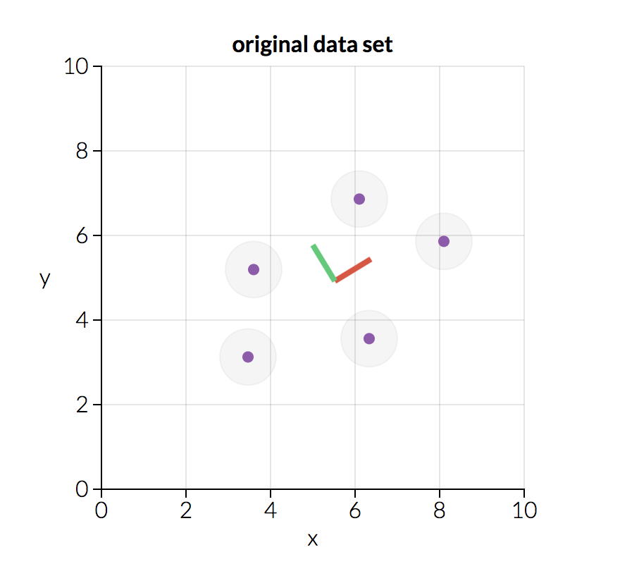
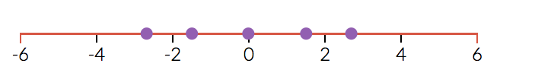
Principal Component Analysis picks out the most important dimensions
First Principal Component
Notes:
Pca a method of dimensionality reduction - break the curse of dimensionality.
Find import features/combinations of features.
E.x. feature 1 could be 0.2*(2.F) - (0.8)*(3.B)

Slide 4

Unsupervised Clustering
Letting the data tell the story to us
Data
Us
Notes:
We don’t want to have to make our own splits (and we can’t in dimensions>3) so we need an algorithm to do it for us. Luckily, mathematicians have been thinking about this problem for a while.

Slide 5
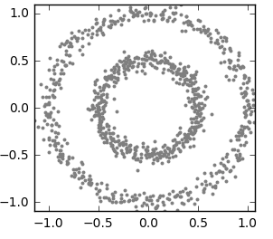
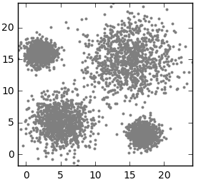
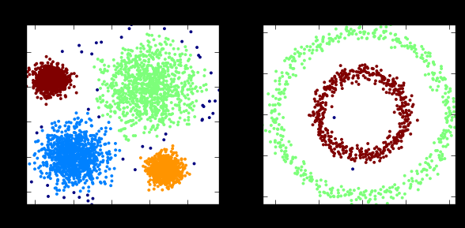
Finding Clusters
Notes:
A good algorithm should be able to do both of these tasks. Our data fits better in with image on the left (it can be transformed to normal data and left image are circles of normal data) so we choose k means, an algorithm known to cluster data like this well. If any one is super curious as to how k means works we can get into it by clicking the image on the left.
Add black and white

Slide 6
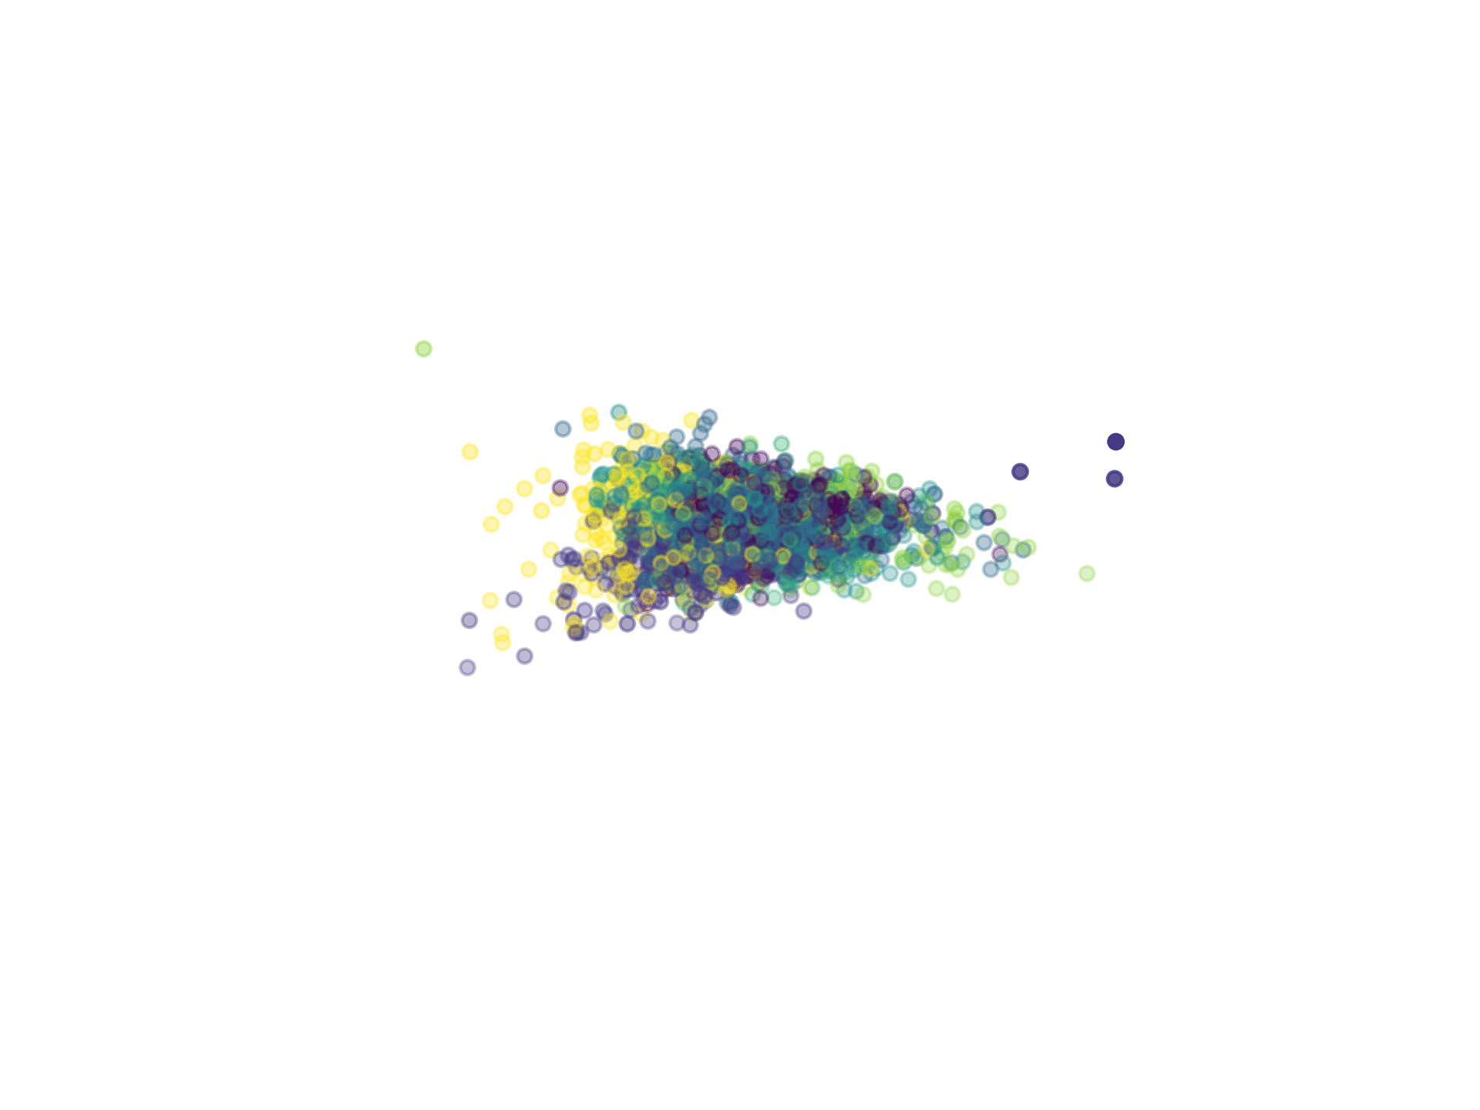
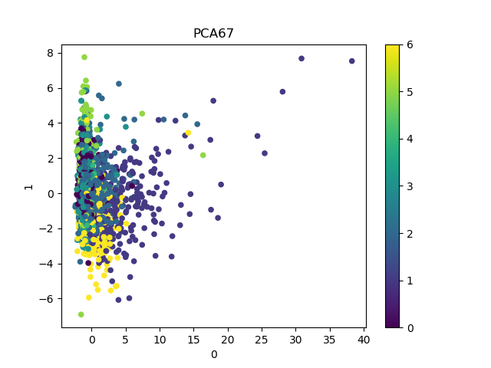
Cluster Visualization
Projected on demographic data
Notes:
The fact that our clusters are still roughly together using data that they were not based on is very good news for 2 things:
Our PCA & clustering algorithm
The relationship between locus functional groupings and economic outcomes

Slide 7
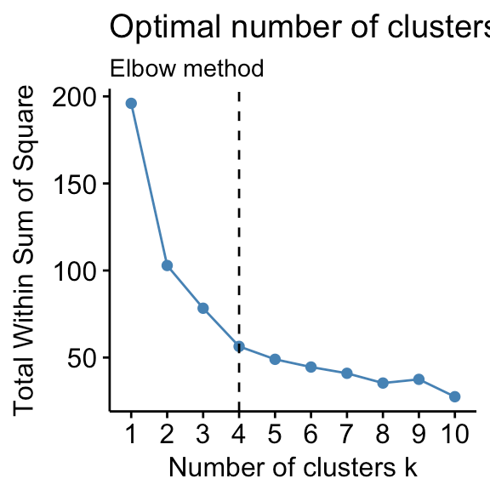
Elbow Rule
Clustering
Appendix
Notes:
We have 2 goals, minimize # of clusters (principle of parsimony/occams razor - simpler model is better all else equal), and minimize squared distances within clusters. So we look at the elbow, the place where our lowering of distance gets very diminishing returns.

